Slide 1

FOOSE: Football Operator and Optical Soccer Engine
Sponsored by
Group 30:
Nathaniel Enos (EE)
Patrick Fenelon (CpE)
Skyler Goodell (CpE)
Nick Phillips (CpE)

Slide 2

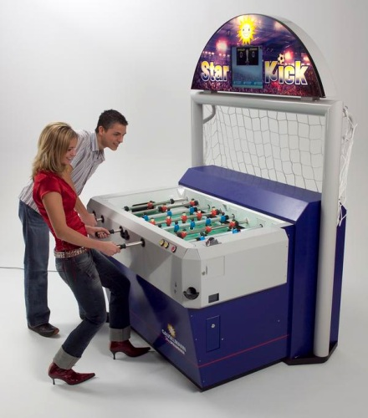
What is Foose?

Slide 3
Motivation
Diverse Engineering team
Optical Image Processing
Artificial Intelligence
Software Engineering
Linear Control Systems
Robotics
SoarTech Sponsorship
Showcase artificial intelligence in a “cool” domain
Notes:
Begin by introducing myself
Transition:
In the game’s century long history little has changed. We are not the first to attempt this automization. However we have some goals to differentiate our attempt from those before us.

Slide 4
Goals
Cost
More affordable than competition
Size
Minimize modification to the table
Entertaining/Competitive
Entertaining to a novice user

Slide 5
Specifications
Component | Metric | Value
Camera | Framerate | 30 fps
Camera | Resolution | 640x480
Central Computer | Delay | 33 ms
Lateral Motion | Speed | 1 m/s
Lateral Motion | Accuracy | 2.5cm
Kick | Speed | 2 m/s

Slide 6
FOOSE Layout
Table State Interpretation
AI
RCB
Motors
Linear Steppers
Radial Steppers

Slide 7
FOOSE Layout
Table State Interpretation
AI
RCB
Motors
Linear Steppers
Radial Steppers

Slide 8
FOOSE Layout
Table State Interpretation
AI
RCB
Motors
Linear Steppers
Radial Steppers

Slide 9
FOOSE Layout
Table State Interpretation
AI
RCB
Motors
Linear Steppers
Radial Steppers

Slide 10
FOOSE Layout
Table State Interpretation
AI
RCB
Motors
Linear Steppers
Radial Steppers

Slide 11
FOOSE Layout
Table State Interpretation
AI
RCB
Motors
Linear Steppers
Radial Steppers

Slide 12
Table State Interpretation Overview
Image Acquisition
Table Normalization
Candidate Detection
Rod and feet rejection phase 1
Weighted Hough
Feet rejection phase 2
Physics Engine

Slide 13
Table State Interpretation Overview
Image Acquisition
Table Normalization
Candidate Detection
Rod and feet rejection phase 1
Weighted Hough
Feet rejection phase 2
Physics Engine

Slide 14
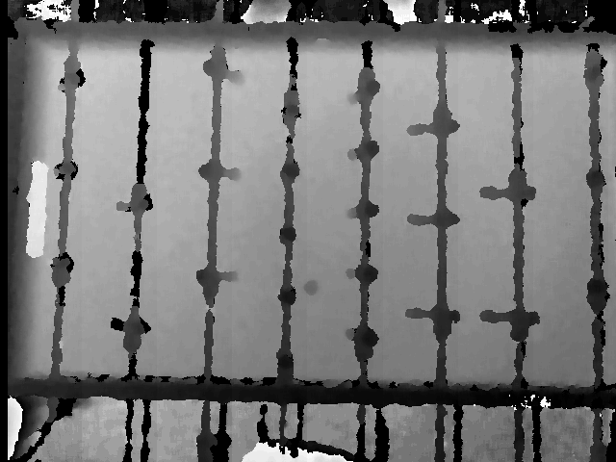
Depth Camera (Kinect)
Lighting irrelevant
No motion blur
Ball exists on unique depth level

Slide 15
Camera Selection
Camera | Cost | Resolution | Output Interpretation
Logitech QC 9000 | $0 Acquired (Retail $79.99) | Color - 1600 x 1200 | USB to Emgu CV C# / Open CV
Kinect (for Windows) | $0 Acquired (Retail $229.99) | Color - 1280 x 960 Depth- 640 x 480 | USB to Kinect SDK C#
TCM8230MD | $9.95 + PCB cost | Color - 640 x 480 | jpeg via I²C

Slide 16
Camera Selection
Camera | Cost | Resolution | Output Interpretation
Logitech QC 9000 | $0 Acquired (Retail $79.99) | Color - 1600 x 1200 | USB to Emgu CV C# / Open CV
Kinect (for Windows) | $0 Acquired (Retail $229.99) | Color - 1280 x 960 Depth- 640 x 480 | USB to Kinect SDK C#
TCM8230MD | $9.95 + PCB cost | Color - 640 x 480 | jpeg via I²C

Slide 17
Camera Selection
Camera | Cost | Resolution | Output Interpretation
Logitech QC 9000 | $0 Acquired (Retail $79.99) | Color - 1600 x 1200 | USB to Emgu CV C# / Open CV
Kinect (for Windows) | $0 Acquired (Retail $229.99) | Color - 1280 x 960 Depth- 640 x 480 | USB to Kinect SDK C#
TCM8230MD | $9.95 + PCB cost | Color - 640 x 480 | jpeg via I²C

Slide 18
Camera Selection
Camera | Cost | Resolution | Output Interpretation
Logitech QC 9000 | $0 Acquired (Retail $79.99) | Color - 1600 x 1200 | USB to Emgu CV C# / Open CV
Kinect (for Windows) | $0 Acquired (Retail $229.99) | Color - 1280 x 960 Depth- 640 x 480 | USB to Kinect SDK C#
TCM8230MD | $9.95 + PCB cost | Color - 640 x 480 | jpeg via I²C

Slide 19
Table State Interpretation Overview
Image Acquisition
Table Normalization
Candidate Detection
Rod and feet rejection phase 1
Weighted Hough
Feet rejection phase 2
Physics Engine

Slide 20
Table State Interpretation Overview
Image Acquisition
Table Normalization
Candidate Detection
Rod and feet rejection phase 1
Weighted Hough
Feet rejection phase 2
Physics Engine

Slide 21
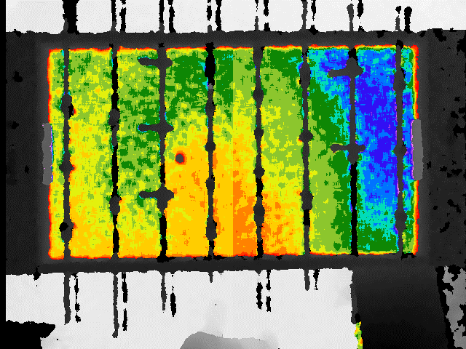
Table Normalization
Use depth to select table
Correct height with average table height

Slide 22
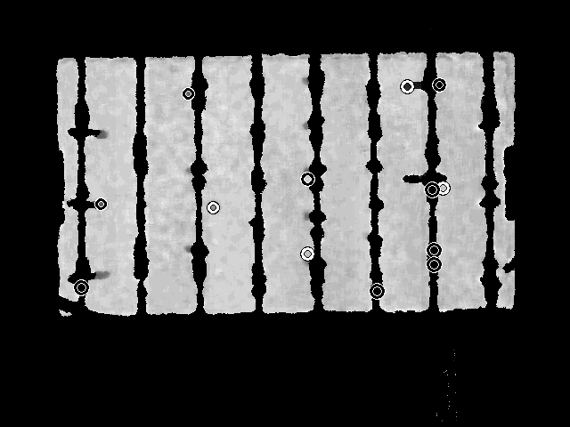
Table Normalization
Use depth to select table
Correct height with average table height

Slide 23
Table State Interpretation Overview
Image Acquisition
Table Normalization
Candidate Detection
Rod and feet rejection phase 1
Weighted Hough
Feet rejection phase 2
Physics Engine

Slide 24
Table State Interpretation Overview
Image Acquisition
Table Normalization
Candidate Detection
Rod and feet rejection phase 1
Weighted Hough
Feet rejection phase 2
Physics Engine

Slide 25
Candidate Selection
Use EMGU Circular Hough transform

Slide 26
Rod and feet rejection phase 1
BFS near pixels of similar depth
If you hit black pixel, then it’s a foot

Slide 27
Table State Interpretation Overview
Image Acquisition
Table Normalization
Candidate Detection
Rod and feet rejection phase 1
Weighted Hough
Feet rejection phase 2
Physics Engine

Slide 28
Table State Interpretation Overview
Image Acquisition
Table Normalization
Candidate Detection
Rod and feet rejection phase 1
Weighted Hough
Feet rejection phase 2
Physics Engine

Slide 29
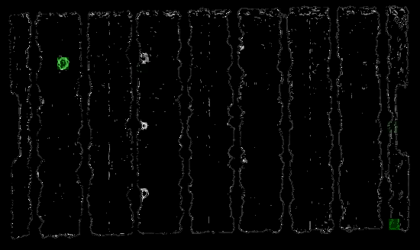
Custom Hough Transform
Convolve image with modified Sobel kernels
Run Hough accumulator on multiple sizes, subtract wrong sizes

Slide 30
Table State Interpretation Overview
Image Acquisition
Table Normalization
Candidate Detection
Rod and feet rejection phase 1
Weighted Hough
Feet rejection phase 2
Physics Engine

Slide 31
Table State Interpretation Overview
Image Acquisition
Table Normalization
Candidate Detection
Rod and feet rejection phase 1
Weighted Hough
Feet rejection phase 2
Physics Engine

Slide 32

feet rejection phase 1
Trace circle around selected candidates, find min/max depth
Ball has uniform depth
Foot has high difference between min and max

Slide 33
Table State Interpretation Overview
Image Acquisition
Table Normalization
Candidate Detection
Rod and feet rejection phase 1
Weighted Hough
Feet rejection phase 2
Physics Engine

Slide 34
Table State Interpretation Overview
Image Acquisition
Table Normalization
Candidate Detection
Rod and feet rejection phase 1
Weighted Hough
Feet rejection phase 2
Physics Engine

Slide 35
Ball Tracker
Filter out false positive detections from the CV
Give a “confidence” measure for each new detection based on previous nearby detections
Project the ball forward using a physics model
Based on velocity of previous frames
Includes bounces off of walls
Notes:
Patrick should really say this:
Because there are false positives still through the CV, we use a ball tracking method to kick out those readings. Our implementation uses a collection of potential ball positions so that each time the CV reads a new position, we output to the AI only the most confident position.
We also project each potential ball position forward in time using an integrated physics model.

Slide 36
FOOSE Layout
Table State Interpretation
AI
RCB
Motors
Linear Steppers
Radial Steppers

Slide 37
FOOSE Layout
Table State Interpretation
AI
RCB
Motors
Linear Steppers
Radial Steppers

Slide 38
AI Overview
Responsible for:
Taking current ball state from Physics Engine
Calculating a move
Outputting that move to the correct RCB
Standard AMD64 computer (along with CV)
C#
Ease of coding
Compatibility with CV codebase

Slide 39
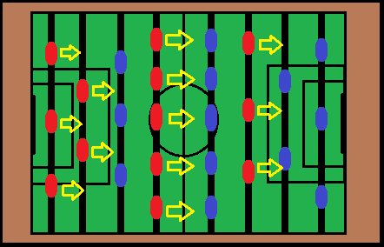
AI Strategy: Movement
For each rod, where can we block the ball?
How can we get there?
Notes:
This is what starkick does

Slide 40
AI Strategy: Movement
Take in position and velocity from Physics
Choose closest puppet capable of interception
Based on last issued position
For each rod, take action based on the following rules:

Slide 41
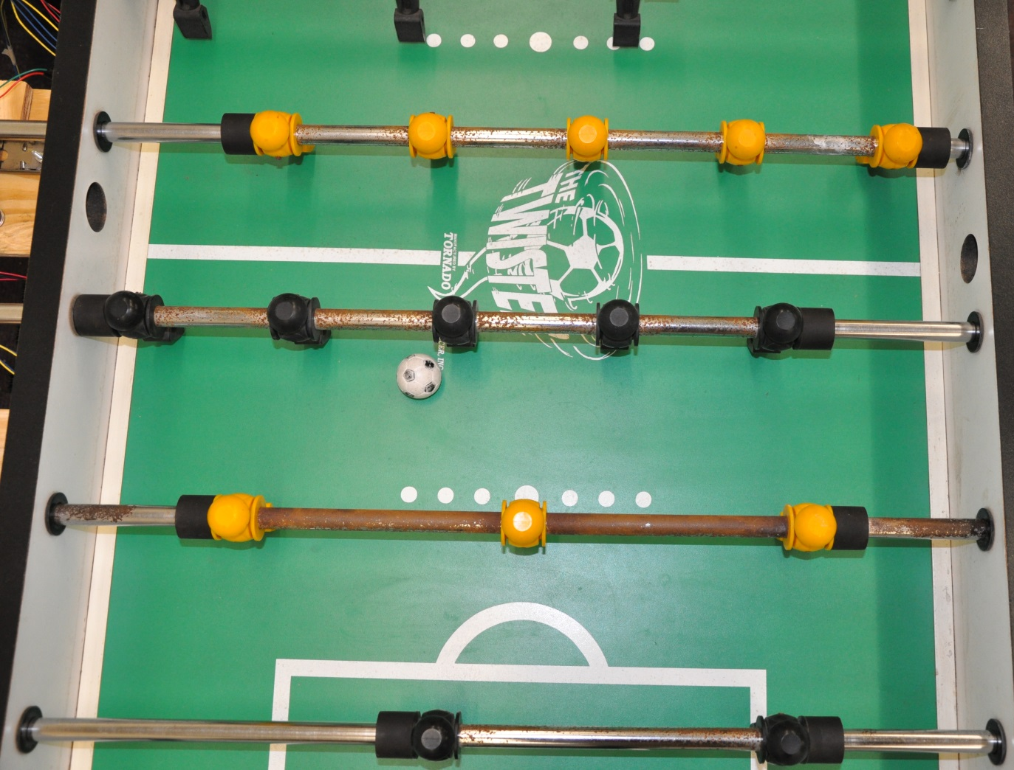
AI Strategy: Movement
If the ball is behind the rod, center the rod

Slide 42
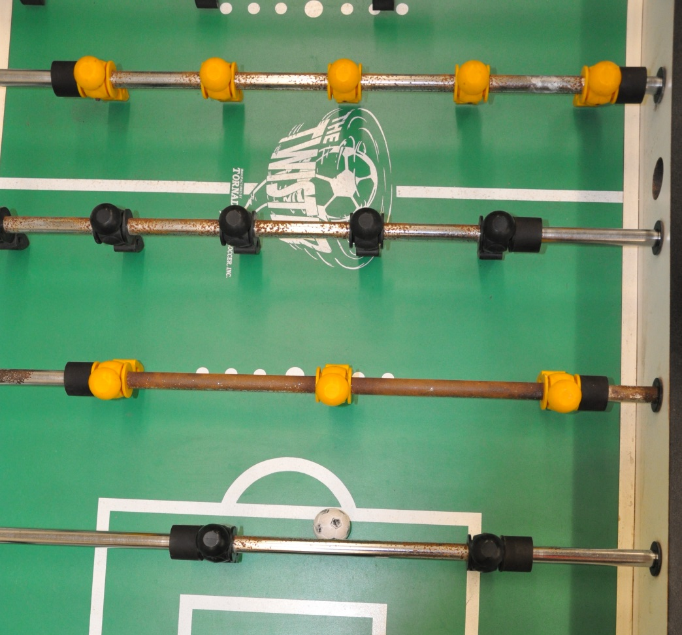
AI Strategy: Movement
If ahead, but slow or moving away, line up directly

Slide 43
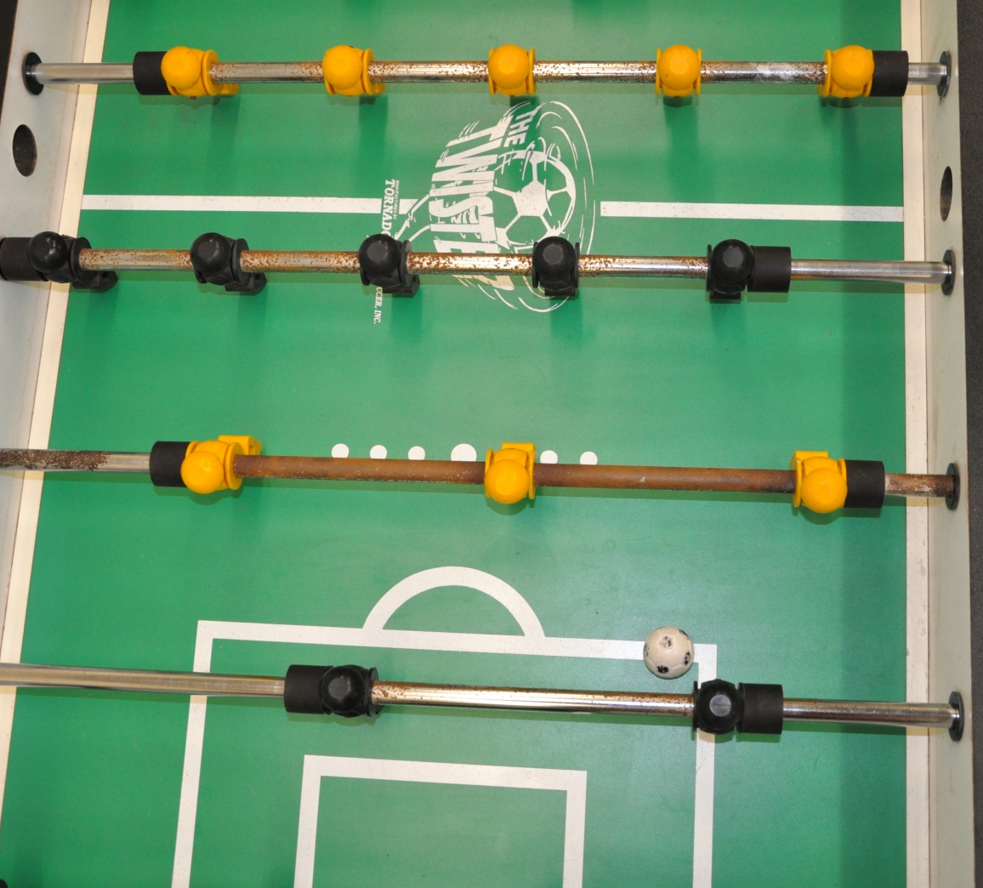
AI Strategy: Movement
If neither of those, project future position and move to intercept

Slide 44
AI strategy: kick
Timing is the most important factor
Project position 0.25s into future
Taking velocity into account
Kick if it will be within a range of the rod
Tuned values

Slide 45
AI Strategy: optimization
Don’t update too quickly
In testing, updating quickly led to jerky movement
Slower updating allows for better performance
Don’t send small updates
Use threshold value that shrinks with time and distance from rod
Reduces jitter by discarding small moves

Slide 46
AI: RESPONSIBILITIES
Initialization
Automatically finds each RCB
Gets correct number
Calibration
RCBs automatically calibrate on boot
AI requests and uses this value

Slide 47
FOOSE Layout
Table State Interpretation
AI
RCB
Motors
Linear Steppers
Radial Steppers

Slide 48
FOOSE Layout
Table State Interpretation
AI
RCB
Motors
Linear Steppers
Radial Steppers

Slide 49
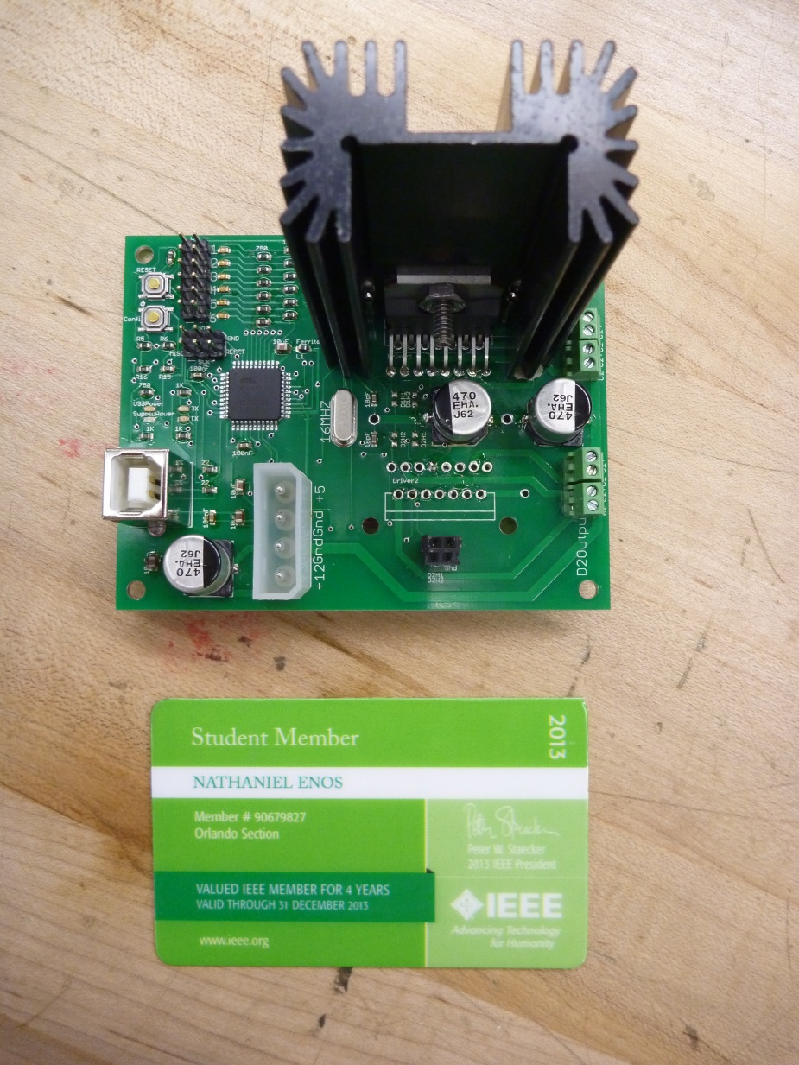
Rod Control Board (RCB)
Purpose
Take in desired location and kick state of players from computer
Take in sensor data
Power and Control Actuators

Slide 51
Design Decisions
Microcontroller
Motor controller
Control Method

Slide 52
Microcontroller decision
Part | # of I/O | Speed | Arduino Friendly | USB on-board | Cost
MSP430 | 10 | 16 MHz | Sort of | No | $ 1.10
AVR ATmega32u4 | 26 | 16 MHz | Yes | Yes | $ 6.04
AVR Atmega2560 | 86 | 16 MHz | Yes | Yes | $ 17.97
PIC18F4550 | 35 | 48 MHz | No | Yes | $ 6.68

Slide 53
Microcontroller decision
Part | # of I/O | Speed | Arduino Friendly | USB on-board | Cost
MSP430 | 10 | 16 MHz | Sort of | No | $ 1.10
AVR ATmega32u4 | 26 | 16 MHz | Yes | Yes | $ 6.04
AVR Atmega2560 | 86 | 16 MHz | Yes | Yes | $ 17.97
PIC18F4550 | 35 | 48 MHz | No | Yes | $ 6.68

Slide 54
Microcontroller decision
Part | # of I/O | Speed | Arduino Friendly | USB on-board | Cost
MSP430 | 10 | 16 MHz | Sort of | No | $ 1.10
AVR ATmega32u4 | 26 | 16 MHz | Yes | Yes | $ 6.04
AVR Atmega2560 | 86 | 16 MHz | Yes | Yes | $ 17.97
PIC18F4550 | 35 | 48 MHz | No | Yes | $ 6.68

Slide 55
Microcontroller decision
Part | # of I/O | Speed | Arduino Friendly | USB on-board | Cost
MSP430 | 10 | 16 MHz | Sort of | No | $ 1.10
AVR ATmega32u4 | 26 | 16 MHz | Yes | Yes | $ 6.04
AVR Atmega2560 | 86 | 16 MHz | Yes | Yes | $ 17.97
PIC18F4550 | 35 | 48 MHz | No | Yes | $ 6.68

Slide 56
Motor controller decision
Part | Continuous Current Rating | Operating Voltage | On-board Microstepping | Control Complexity | Unit Cost (USD)
Stepper Driver DVR8825 | 1.8 A | 8.2-45 V | Yes | Low | $6.53
Stepper Driver A4975 | 1.5 A | 5-50 V | Yes | Low | $3.69
H-Bridge LMD18200 | 3.0 A | 12-55 V | No | High | $16.04
Dual H-Bridge L298N | 4.0 A | 2.5-46 V | No | High | $2.95

Slide 57
Motor controller decision
Part | Continuous Current Rating | Operating Voltage | On-board Microstepping | Control Complexity | Unit Cost (USD)
Stepper Driver DVR8825 | 1.8 A | 8.2-45 V | Yes | Low | $6.53
Stepper Driver A4975 | 1.5 A | 5-50 V | Yes | Low | $3.69
H-Bridge LMD18200 | 3.0 A | 12-55 V | No | High | $16.04
Dual H-Bridge L298N | 4.0 A | 2.5-46 V | No | High | $2.95

Slide 58
Motor controller decision
Part | Continuous Current Rating | Operating Voltage | On-board Microstepping | Control Complexity | Unit Cost (USD)
Stepper Driver DVR8825 | 1.8 A | 8.2-45 V | Yes | Low | $6.53
Stepper Driver A4975 | 1.5 A | 5-50 V | Yes | Low | $3.69
H-Bridge LMD18200 | 3.0 A | 12-55 V | No | High | $16.04
Dual H-Bridge L298N | 4.0 A | 2.5-46 V | No | High | $2.95

Slide 59
Motor controller decision
Part | Continuous Current Rating | Operating Voltage | On-board Microstepping | Control Complexity | Unit Cost (USD)
Stepper Driver DVR8825 | 1.8 A | 8.2-45 V | Yes | Low | $6.53
Stepper Driver A4975 | 1.5 A | 5-50 V | Yes | Low | $3.69
H-Bridge LMD18200 | 3.0 A | 12-55 V | No | High | $16.04
Dual H-Bridge L298N | 4.0 A | 2.5-46 V | No | High | $2.95

Slide 60
Motor controller decision
Part | Continuous Current Rating | Operating Voltage | On-board Microstepping | Control Complexity | Unit Cost (USD)
Stepper Driver DVR8825 | 1.8 A | 8.2-45 V | Yes | Low | $6.53
Stepper Driver A4975 | 1.5 A | 5-50 V | Yes | Low | $3.69
H-Bridge LMD18200 | 3.0 A | 12-55 V | No | High | $16.04
Dual H-Bridge L298N | 4.0 A | 2.5-46 V | No | High | $2.95

Slide 61
Motor controller decision
Part | Continuous Current Rating | Operating Voltage | On-board Microstepping | Control Complexity | Unit Cost (USD)
Stepper Driver DVR8825 | 1.8 A | 8.2-45 V | Yes | Low | $6.53
Stepper Driver A4975 | 1.5 A | 5-50 V | Yes | Low | $3.69
H-Bridge LMD18200 | 3.0 A | 12-55 V | No | High | $16.04
Dual H-Bridge L298N | 4.0 A | 2.5-46 V | No | High | $2.95

Slide 62
Motor controller decision
Part | Continuous Current Rating | Operating Voltage | On-board Microstepping | Control Complexity | Unit Cost (USD)
Stepper Driver DVR8825 | 1.8 A | 8.2-45 V | Yes | Low | $6.53
Stepper Driver A4975 | 1.5 A | 5-50 V | Yes | Low | $3.69
H-Bridge LMD18200 | 3.0 A | 12-55 V | No | High | $16.04
Dual H-Bridge L298N | 4.0 A | 2.5-46 V | No | High | $2.95

Slide 63
Stepper Motor Control
Control Method | Complexity | Incremental Cost | Drift Error
Closed-Loop | High | $ 119.80 | No
Open-Loop | Low | $ 16.00 | Yes

Slide 64
Stepper Motor Control
Control Method | Complexity | Incremental Cost | Drift Error
Closed-Loop | High | $ 119.80 | No
Open-Loop | Low | $ 16.00 | Yes

Slide 65
Stepper Motor Control
Control Method | Complexity | Incremental Cost | Drift Error
Closed-Loop | High | $ 119.80 | No
Open-Loop | Low | $ 16.00 | Yes

Slide 66
Power
Using standard PC power supplies for the PC and PCB boards
Using 12 VDC and 5 VDC

Slide 67
FOOSE Layout
Table State Interpretation
AI
RCB
Motors
Linear Steppers
Radial Steppers

Slide 68
FOOSE Layout
Table State Interpretation
AI
RCB
Motors
Linear Steppers
Radial Steppers

Slide 69
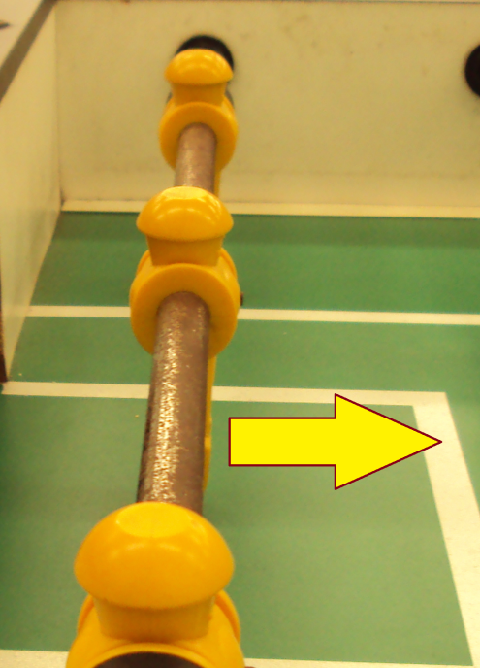
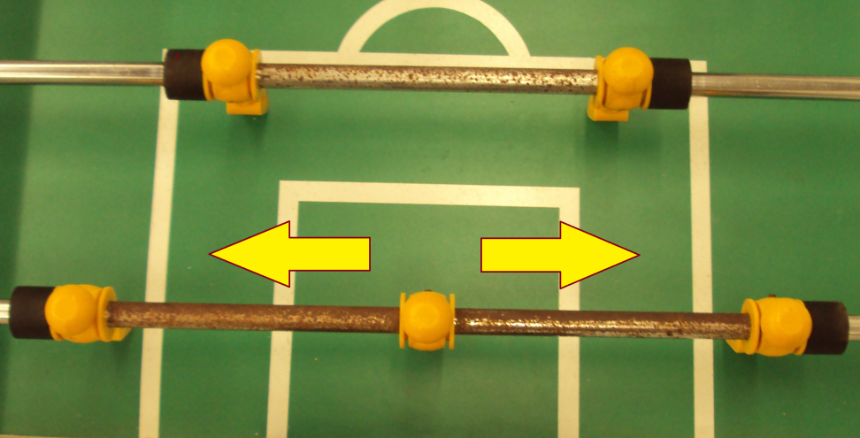
Mechanical/Robotic Design
Two primary actuations:
Linear Motion
Rotational Motion
Notes:
Discuss benefits of fooseball domain.
*transition: we will need some form of actuation, but we need a baseline to choose from. (stress that what I will show you is for estimation purposes and not a hard requirement. It helped us make decisions)

Slide 70
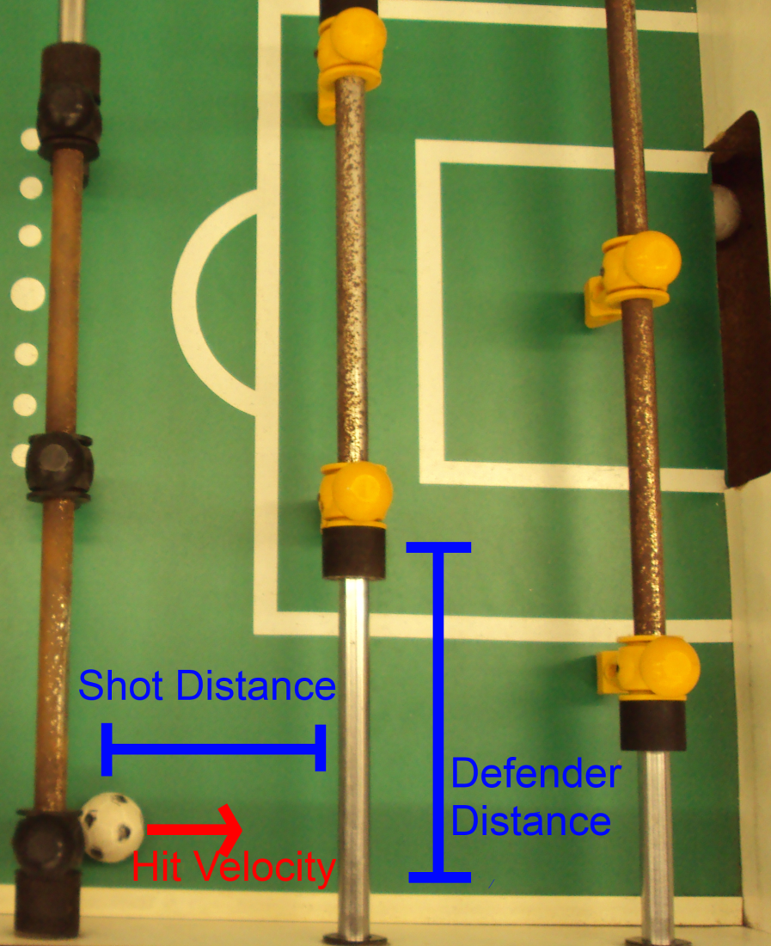
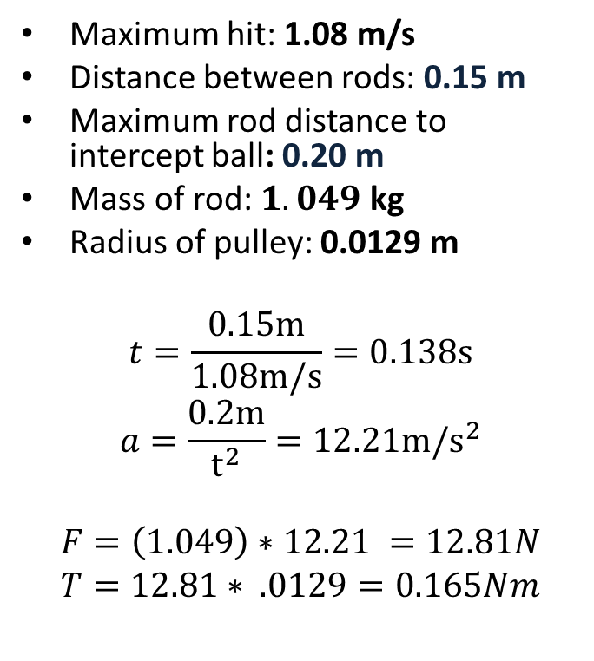
Linear Motion Specifications
CONCLUSION: 0.165Nm Torque at 1247 rpm

Slide 71
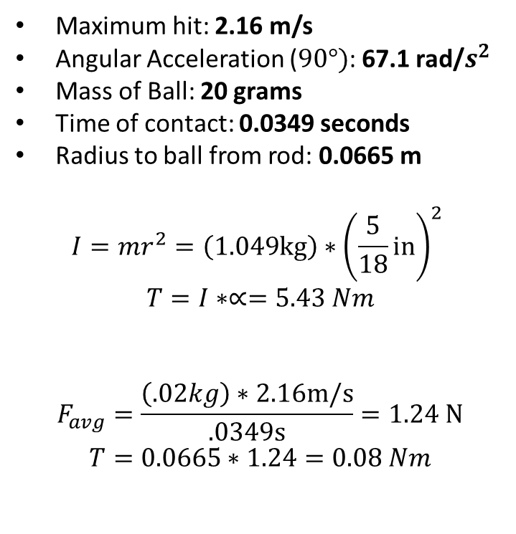
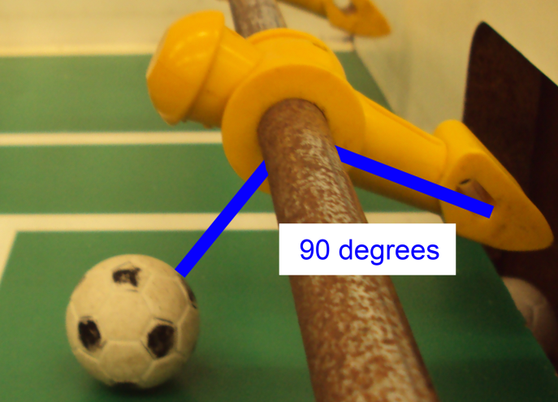
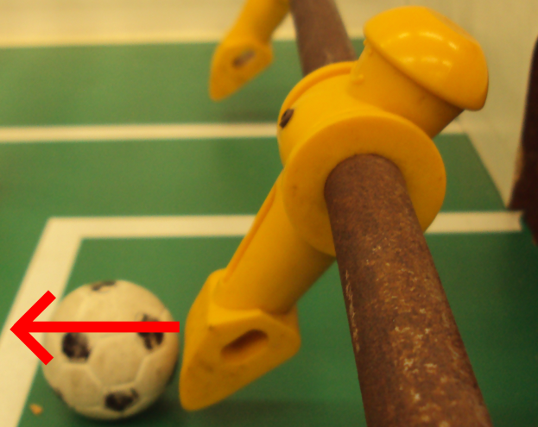
Rotational Motion Specifications
CONCLUSION: 5.51 Nm Torque at 310 rpm

Slide 72
Motor Options
Name | Cost | Voltage Rating | Current Rating | Watts (max) | Torque | RPM
Johnson Electric HC615-64823 | $5.95 | 6-24 VDC | 0.22A | 5.3 W | 0.011 Nm | 4700
CIM AM802-001A | $28.00 | 12 VDC | 68 A | 337 W | 2.42 Nm | 5310
BaneBot RS775 | $12.75 | 6-18 VDC | 5.7 A | 63.4 W | 0.083Nm | 7300
Sparkfun ROB-09238 | $14.95 | 12 V | 0.33 A | 4 W | 0.016 Nm | 180
NEMA 6627T31 | $86.67 | 12–40 V | 0.45 A | 18 W | 0.057 Nm | 3000
Japan Servo KH56JM2-901 | $91.84 | 12-24 V | 1.0 A | 12 W | 0.3 Nm | 1500
LINEAR: 0.165Nm Torque at 1247 rpm ROTATIONAL: 5.51 Nm Torque at 310 rpm
Notes:
http://www.engineeringtoolbox.com/electrical-motors-hp-torque-rpm-d_1503.html
Notes:
http://www.skycraftsurplus.com/dchobbymotor6-24vdc.aspx
http://www.andymark.com/CIM-motor-FIRST-p/am-0255.htm
http://banebots.com/pc/MOTOR-BRUSH/M5-RS775-12
https://www.sparkfun.com/products/9238
http://www.mcmaster.com/#stepper-motors/=lj77o5
http://www.nidec-servo.com/en/digital/c_ste/index.html
Is the one we found on ebay: KH56JM2-901B004

Slide 73
Motor Options
Name | Cost | Voltage Rating | Current Rating | Watts (max) | Torque | RPM
Johnson Electric HC615-64823 | $5.95 | 6-24 VDC | 0.22A | 5.3 W | 0.011 Nm | 4700
CIM AM802-001A | $28.00 | 12 VDC | 68 A | 337 W | 2.42 Nm | 5310
BaneBot RS775 | $12.75 | 6-18 VDC | 5.7 A | 63.4 W | 0.083Nm | 7300
Sparkfun ROB-09238 | $14.95 | 12 V | 0.33 A | 4 W | 0.016 Nm | 180
NEMA 6627T31 | $86.67 | 12–40 V | 0.45 A | 18 W | 0.057 Nm | 3000
Japan Servo KH56JM2-901 | $91.84 | 12-24 V | 1.0 A | 12 W | 0.3 Nm | 1500
LINEAR: 0.165Nm Torque at 1247 rpm ROTATIONAL: 5.51 Nm Torque at 310 rpm
Notes:
http://www.engineeringtoolbox.com/electrical-motors-hp-torque-rpm-d_1503.html
Notes:
http://www.skycraftsurplus.com/dchobbymotor6-24vdc.aspx
http://www.andymark.com/CIM-motor-FIRST-p/am-0255.htm
http://banebots.com/pc/MOTOR-BRUSH/M5-RS775-12
https://www.sparkfun.com/products/9238
http://www.mcmaster.com/#stepper-motors/=lj77o5
http://www.nidec-servo.com/en/digital/c_ste/index.html
Is the one we found on ebay: KH56JM2-901B004

Slide 74
Motor Options
Name | Cost | Voltage Rating | Current Rating | Watts (max) | Torque | RPM
Johnson Electric HC615-64823 | $5.95 | 6-24 VDC | 0.22A | 5.3 W | 0.011 Nm | 4700
CIM AM802-001A | $28.00 | 12 VDC | 68 A | 337 W | 2.42 Nm | 5310
BaneBot RS775 | $12.75 | 6-18 VDC | 5.7 A | 63.4 W | 0.083Nm | 7300
Sparkfun ROB-09238 | $14.95 | 12 V | 0.33 A | 4 W | 0.016 Nm | 180
NEMA 6627T31 | $86.67 | 12–40 V | 0.45 A | 18 W | 0.057 Nm | 3000
Japan Servo KH56JM2-901 | $91.84 | 12-24 V | 1.0 A | 12 W | 0.3 Nm | 1500
LINEAR: 0.165Nm Torque at 1247 rpm ROTATIONAL: 5.51 Nm Torque at 310 rpm
Notes:
http://www.engineeringtoolbox.com/electrical-motors-hp-torque-rpm-d_1503.html
Notes:
http://www.skycraftsurplus.com/dchobbymotor6-24vdc.aspx
http://www.andymark.com/CIM-motor-FIRST-p/am-0255.htm
http://banebots.com/pc/MOTOR-BRUSH/M5-RS775-12
https://www.sparkfun.com/products/9238
http://www.mcmaster.com/#stepper-motors/=lj77o5
http://www.nidec-servo.com/en/digital/c_ste/index.html
Is the one we found on ebay: KH56JM2-901B004

Slide 75
Motor Options
Name | Cost | Voltage Rating | Current Rating | Watts (max) | Torque | RPM
Johnson Electric HC615-64823 | $5.95 | 6-24 VDC | 0.22A | 5.3 W | 0.011 Nm | 4700
CIM AM802-001A | $28.00 | 12 VDC | 68 A | 337 W | 2.42 Nm | 5310
BaneBot RS775 | $12.75 | 6-18 VDC | 5.7 A | 63.4 W | 0.083Nm | 7300
Sparkfun ROB-09238 | $14.95 | 12 V | 0.33 A | 4 W | 0.016 Nm | 180
NEMA 6627T31 | $86.67 | 12–40 V | 0.45 A | 18 W | 0.057 Nm | 3000
Japan Servo KH56JM2-901 | $91.84 | 12-24 V | 1.0 A | 12 W | 0.3 Nm | 1500
LINEAR: 0.165Nm Torque at 1247 rpm ROTATIONAL: 5.51 Nm Torque at 310 rpm
Notes:
http://www.engineeringtoolbox.com/electrical-motors-hp-torque-rpm-d_1503.html
Notes:
http://www.skycraftsurplus.com/dchobbymotor6-24vdc.aspx
http://www.andymark.com/CIM-motor-FIRST-p/am-0255.htm
http://banebots.com/pc/MOTOR-BRUSH/M5-RS775-12
https://www.sparkfun.com/products/9238
http://www.mcmaster.com/#stepper-motors/=lj77o5
http://www.nidec-servo.com/en/digital/c_ste/index.html
Is the one we found on ebay: KH56JM2-901B004

Slide 76
Motor Options
Name | Cost | Voltage Rating | Current Rating | Watts (max) | Torque | RPM
Johnson Electric HC615-64823 | $5.95 | 6-24 VDC | 0.22A | 5.3 W | 0.011 Nm | 4700
CIM AM802-001A | $28.00 | 12 VDC | 68 A | 337 W | 2.42 Nm | 5310
BaneBot RS775 | $12.75 | 6-18 VDC | 5.7 A | 63.4 W | 0.083Nm | 7300
Sparkfun ROB-09238 | $14.95 | 12 V | 0.33 A | 4 W | 0.016 Nm | 180
NEMA 6627T31 | $86.67 | 12–40 V | 0.45 A | 18 W | 0.057 Nm | 3000
Japan Servo KH56JM2-901 | $ 8.33 | 12-24 V | 1.0 A | 12 W | 0.3 Nm | 1500
LINEAR: 0.165Nm Torque at 1247 rpm ROTATIONAL: 5.51 Nm Torque at 310 rpm
Notes:
http://www.engineeringtoolbox.com/electrical-motors-hp-torque-rpm-d_1503.html
Transition:
None of the motors that we searched really had the desirable kick torque, the only one that had potential was the CIM motor. So we had to address this problem in different ways.
Notes:
http://www.skycraftsurplus.com/dchobbymotor6-24vdc.aspx
http://www.andymark.com/CIM-motor-FIRST-p/am-0255.htm
http://banebots.com/pc/MOTOR-BRUSH/M5-RS775-12
https://www.sparkfun.com/products/9238
http://www.mcmaster.com/#stepper-motors/=lj77o5
http://www.nidec-servo.com/en/digital/c_ste/index.html
Is the one we found on ebay: KH56JM2-901B004

Slide 77
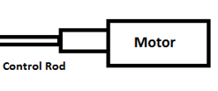
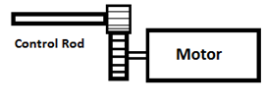
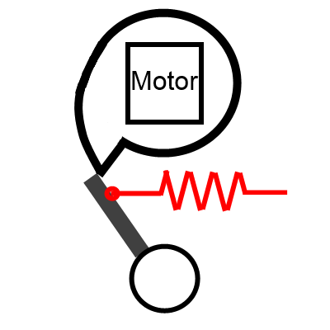
Rotational Motion
Name | Cost
1:1 Mounted Motor | ~$2
Geared Mounted Motor | $15
CAM Kicker | $5
RECALL: 5.51 Nm Torque at 310 rpm
Notes:
Maybe highlight our decision
Update our values from mcmaster

Slide 78
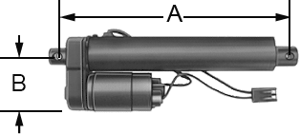
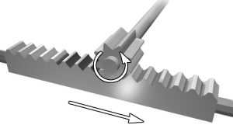
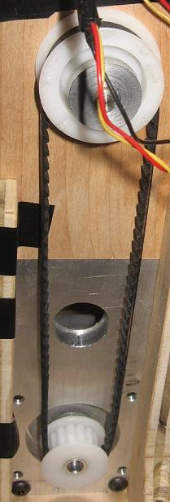
Linear Motion
Name | Cost
Industrial Linear Actuators | $399 - up
Rack and Pinion | $25
Chain or Belt Driven Pulley System | $15
RECALL: 0.165Nm Torque at 1247 rpm
Notes:
Maybe highlight our decision
Update values from mcmaster

Slide 79
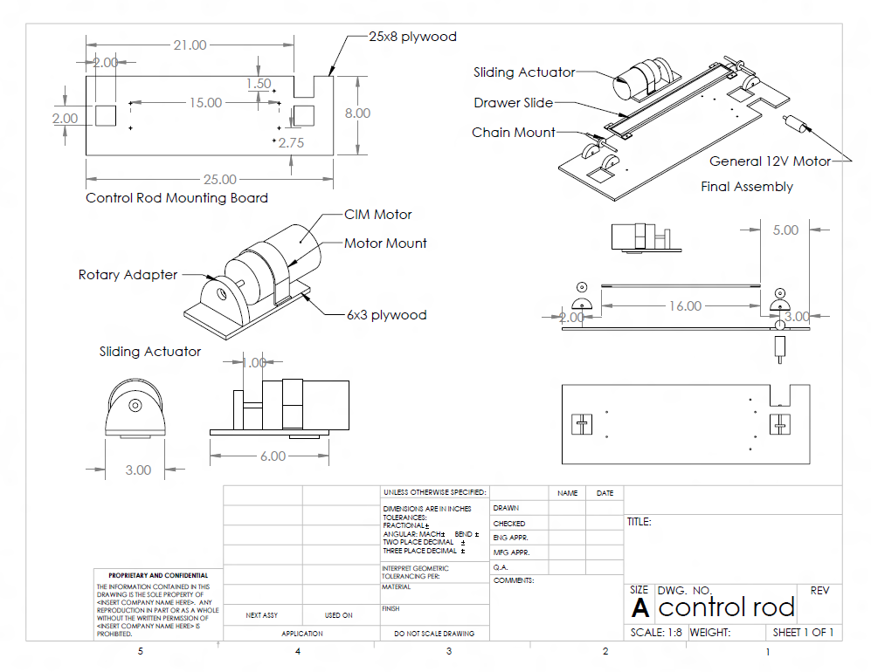
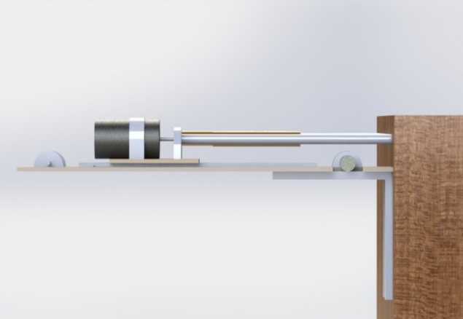
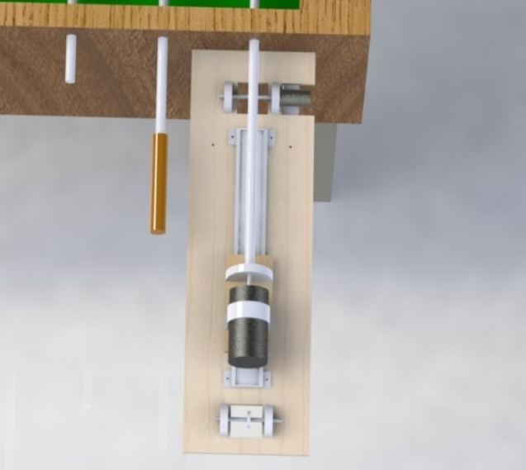
Final Design - CAD
Notes:
MEET THE CAD

Slide 80
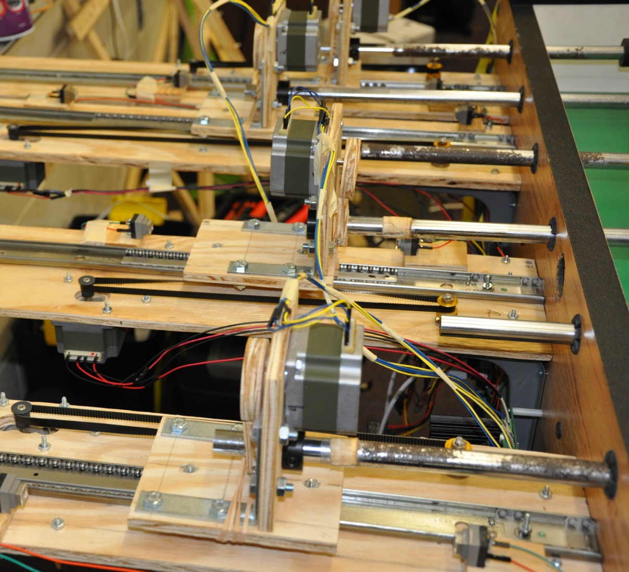
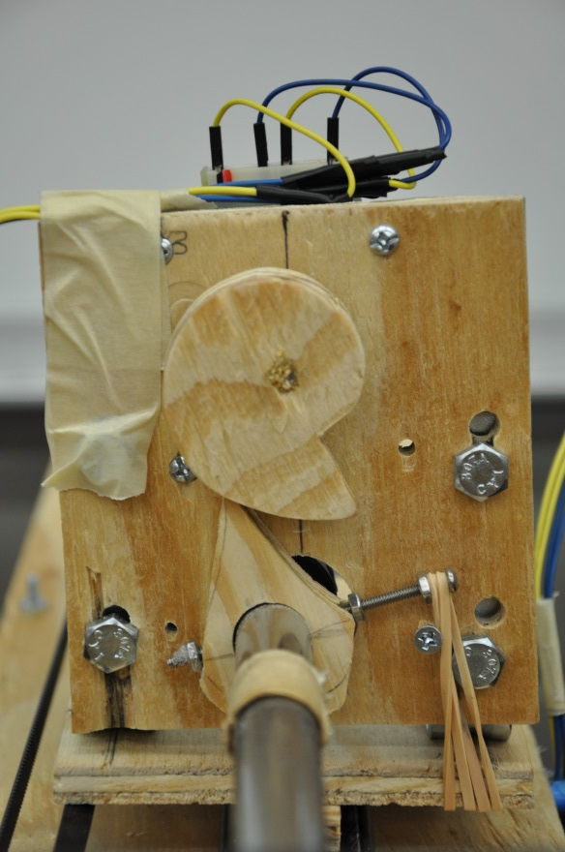
Final Design- Constructed

Slide 81
Foose Administration

Slide 82
Distribution of Work
 | CV | Computer | AI | RCB | Mechanics
Nate |  |  |  | X | X
Patrick | X |  |  | X
Skyler |  |  | X |  | X
Nick |  | X | X

Slide 83
Detailed Budget per Item | Supplier | Price/unit | No. | Total |  | Detailed Budget per Item | Supplier | Price/unit | No. | Total
Foosball Table | Private Seller | $40.00 | 1 | $40.00 |  | 1-1/4" Shoulder Screws | McMaster-Carr | $4.17 | 1 | $4.17
DRV8825 Breakout | BatchPCB | $3.34 | 2 | $6.68 |  | 1" Shoulder Screws | McMaster-Carr | $3.67 | 1 | $3.67
RCB v1 Printing | BatchPCB | $15.99 | 1 | $15.99 |  | 3/8" Titanium Hex Nuts | McMaster-Carr | $2.74 | 2 | $5.48
RCB v2 Printing | BatchPCB | $25.11 | 2 | $50.22 |  | 1/4" Washers | McMaster-Carr | $5.88 | 1 | $5.88
10uF Capacitors | DigiKey | $0.15 | 100 | $15.05 |  | 1/4" Hex Bolts | McMaster-Carr | $4.43 | 1 | $4.43
10mOhm Resistors | DigiKey | $0.02 | 200 | $4.59 |  | 1/4" Hex Nuts | McMaster-Carr | $2.68 | 1 | $2.68
1kOhm Resistors | DigiKey | $0.02 | 200 | $4.59 |  | #6 Machine Screws | Home Depot | $1.18 | 2 | $2.36
DRV8842PWP Stepper Driver | DigiKey | $5.87 | 12 | $70.48 |  | #6 Machine Screw Nuts | Home Depot | $1.18 | 3 | $3.54
120 Ohm Ferrite Chip | DigiKey | $0.06 | 10 | $0.61 |  | Rubber Mallet | Home Depot | $11.68 | 1 | $11.68
1mOhm Resistors | DigiKey | $0.02 | 200 | $4.59 |  | Wood Glue | Home Depot | $2.97 | 1 | $2.97
470uF Capacitors | DigiKey | $0.55 | 50 | $27.50 |  | 10 Sheets Sandpaper | Home Depot | $9.97 | 1 | $9.97
750 Ohm Resistors | DigiKey | $0.02 | 200 | $4.59 |  | Metal Files | Home Depot | $9.97 | 1 | $9.97
100 Ohm Ferrite Chip | DigiKey | $0.07 | 10 | $0.73 |  | Toggle Switch Covers | Skycraft | $3.00 | 3 | $9.00
30 Ohm Ferrite Chip | DigiKey | $0.06 | 10 | $0.61 |  | Double Toggle Switches | Skycraft | $3.50 | 2 | $7.00
470 Ohm Ferrite Chip | DigiKey | $0.07 | 10 | $0.73 |  | Switches | Skycraft | $0.50 | 10 | $5.00
60 Ohm Ferrite Chip | DigiKey | $0.06 | 10 | $0.61 |  | High-watt Resistors | Skycraft | $1.00 | 20 | $20.00
180 Ohm Ferrite Chip | DigiKey | $0.07 | 10 | $0.73 |  | Plastic Standoffs | Skycraft | $20.00 | 0.1 | $2.00
L298N H-Bridges | SparkFun | $2.66 | 12 | $31.92 |  | Corner Braces | Home Depot | $3.77 | 1 | $3.77
L298N Heatsinks | SparkFun | $3.95 | 8 | $31.60 |  | #6 Machine Screws 3/4" | Home Depot | $1.18 | 2 | $2.36
Masking Tape | Home Depot | $2.27 | 1 | $2.27 |  | #6 Machine Screws 1" | Home Depot | $1.18 | 1 | $1.18
Twine | Home Depot | $2.97 | 1 | $2.97 |  | Shelf Brackets | Home Depot | $1.97 | 2 | $3.94
Caution Tape | Home Depot | $5.49 | 1 | $5.49 |  | Plywood 2' x 4' | Home Depot | $9.35 | 1 | $9.35
ATMega32U4 Microcontroller | SparkFun | $6.95 | 5 | $34.75 |  | Cable Clips | Home Depot | $1.69 | 1 | $1.69
Molex Connectors | SparkFun | $0.86 | 10 | $8.60 |  | 4" Cable Ties | Home Depot | $2.38 | 1 | $2.38
USB Female Type B Connector | SparkFun | $0.86 | 10 | $8.60 |  | #6 Machine Screw Nuts | Home Depot | $4.24 | 1 | $4.24
SMD Push-button switch | SparkFun | $0.86 | 10 | $8.60 |  | #3 Machine Screws | Home Depot | $1.18 | 6 | $7.08
SMD LEDs- Green | SparkFun | $4.95 | 2 | $9.90 |  | Self-adhesive Hooks | Home Depot | $8.87 | 1 | $8.87
SMD LEDs- Red | SparkFun | $5.95 | 1 | $5.95 |  | Drill bits | Home Depot | $12.21 | 1 | $12.21
16MHz Oscillator Crystal | SparkFun | $0.95 | 5 | $4.75 |  | Electrical tape | Home Depot | $0.69 | 1 | $0.69
SMD LEDs- Blue | SparkFun | $14.95 | 1 | $14.95 |  | 2" Masking Tape | Home Depot | $3.98 | 1 | $3.98
KH56JM2B004 Stepper Motors | Ebay | $6.94 | 18 | $125.00 |  |  |  | Subtotal |  | $790.85
20-teeth 1/4" Pulley | McMaster-Carr | $10.77 | 1 | $10.77 |  |  |  | Shipping |  | $109.46
14-teeth 1/4" Pulley | McMaster-Carr | $7.51 | 1 | $7.51 |  |  |  | Tax |  | $22.40
320MXL Timing Belt | McMaster-Carr | $5.84 | 1 | $5.84 |  |  |  | $922.71
270MXL Timing Belt | McMaster-Carr | $9.82 | 1 | $9.82 |  |  | Total

Slide 84
Financing
Major sponsor: SoarTech
$500 is about half of budget
Possible sale of completed board
Otherwise, self-funded

Slide 85
Testing
Component
Metric
Value
Actual
Camera
Framerate
30 fps
30 fps
Camera
Resolution
640x480
640x480
Central Computer
Delay
33 ms
35
ms
Lateral Motion
Speed
1 m/s
0.11 m/s
Lateral Motion
Accuracy
2.5cm
0.022cm
Kick
Speed
2
m/s
1.5 m/s

Slide 86
Testing
Component | Metric | Value | Actual
Camera | Framerate | 30 fps | 30 fps
Camera | Resolution | 640x480 | 640x480
Central Computer | Delay | 33 ms | 35 ms
Lateral motion | Speed | 1 m/s | 0.11 m/s
Lateral Motion | Accuracy | 2.5cm | 0.022cm
Kick | Speed | 2 m/s | 1.5 m/s
29.7 fps

